Slide 1

Customer Shopping Behavior Analysis
Uncovering insights from 3,900 purchases to guide strategic business decisions through data-driven analysis of spending patterns, customer segments, and product preferences.

Slide 2
DATASET OVERVIEW
Understanding Our Data Foundation
3,900
18
50
25
Total Purchases
Data Features
Locations
Product Types
Transactions analyzed across all categories
Comprehensive customer and purchase attributes
Geographic diversity in customer base
Diverse inventory across four categories
Dataset includes customer demographics, purchase details, and shopping behavior metrics. Only 37 missing values in Review Rating column, ensuring high data quality for analysis.

Slide 3

DATA PREPARATION
Python Data Cleaning & Engineering
01
02
Data Loading & Exploration
Missing Data Handling
Imported dataset and performed initial structure analysis using pandas
Imputed Review Rating nulls using median rating per product category
03
04
Feature Engineering
Database Integration
Created age_group bins and purchase_frequency_days columns
Connected to PostgreSQL and loaded cleaned data for SQL analysis

Slide 4
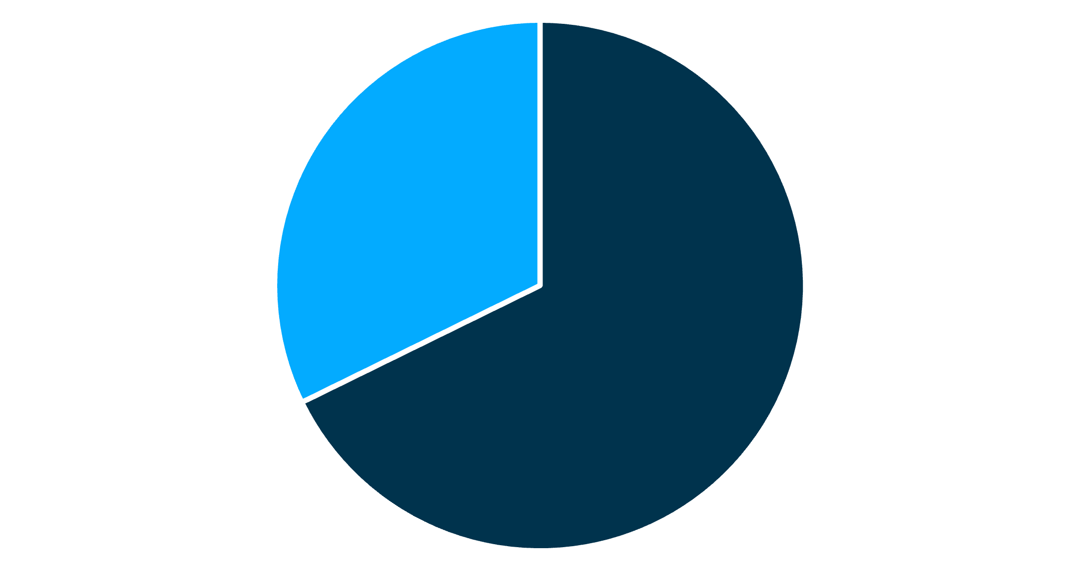
Revenue Analysis by Gender
Male Customers Drive Revenue
Male customers generate $157,890 in total revenue compared to $75,191 from female customers—representing 68% of total sales.
This significant disparity suggests opportunities for targeted marketing campaigns to increase female customer engagement and spending.
Male
Female

Slide 5

TOP PERFORMERS
Product Excellence & Customer Preferences
Highest-Rated Products
77%
77%
76%
Gloves
Sandals
Boots
3.86 average rating
3.84 average rating
3.82 average rating
Discount-Dependent Items
Hat: 50% of purchases use discounts
Sneakers: 49.66% discount rate
Coat: 49.07% discount rate
Sweater: 48.17% discount rate
These products may benefit from strategic pricing adjustments to improve margins.

Slide 6

Customer Segmentation Insights
Loyal Customers
Returning Buyers
New Customers
3,116 customers
701 customers
83 customers
80% of customer base with strong repeat purchase behavior
18% showing positive engagement and growth potential
2% representing fresh acquisition opportunities

Slide 7
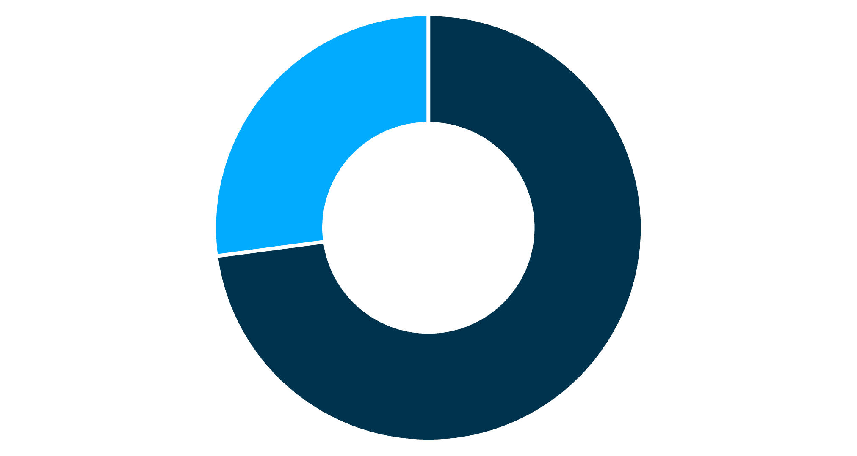
Subscription Status Analysis
Despite similar average spending patterns, subscribers represent only 27% of the customer base but show strong loyalty indicators.
Non-Subscribers
Subscribers
Subscribers
Non-Subscribers
1,053 customers
2,847 customers
$59.49 avg spend
$59.87 avg spend
$62,645 total revenue
$170,436 total revenue

Slide 8
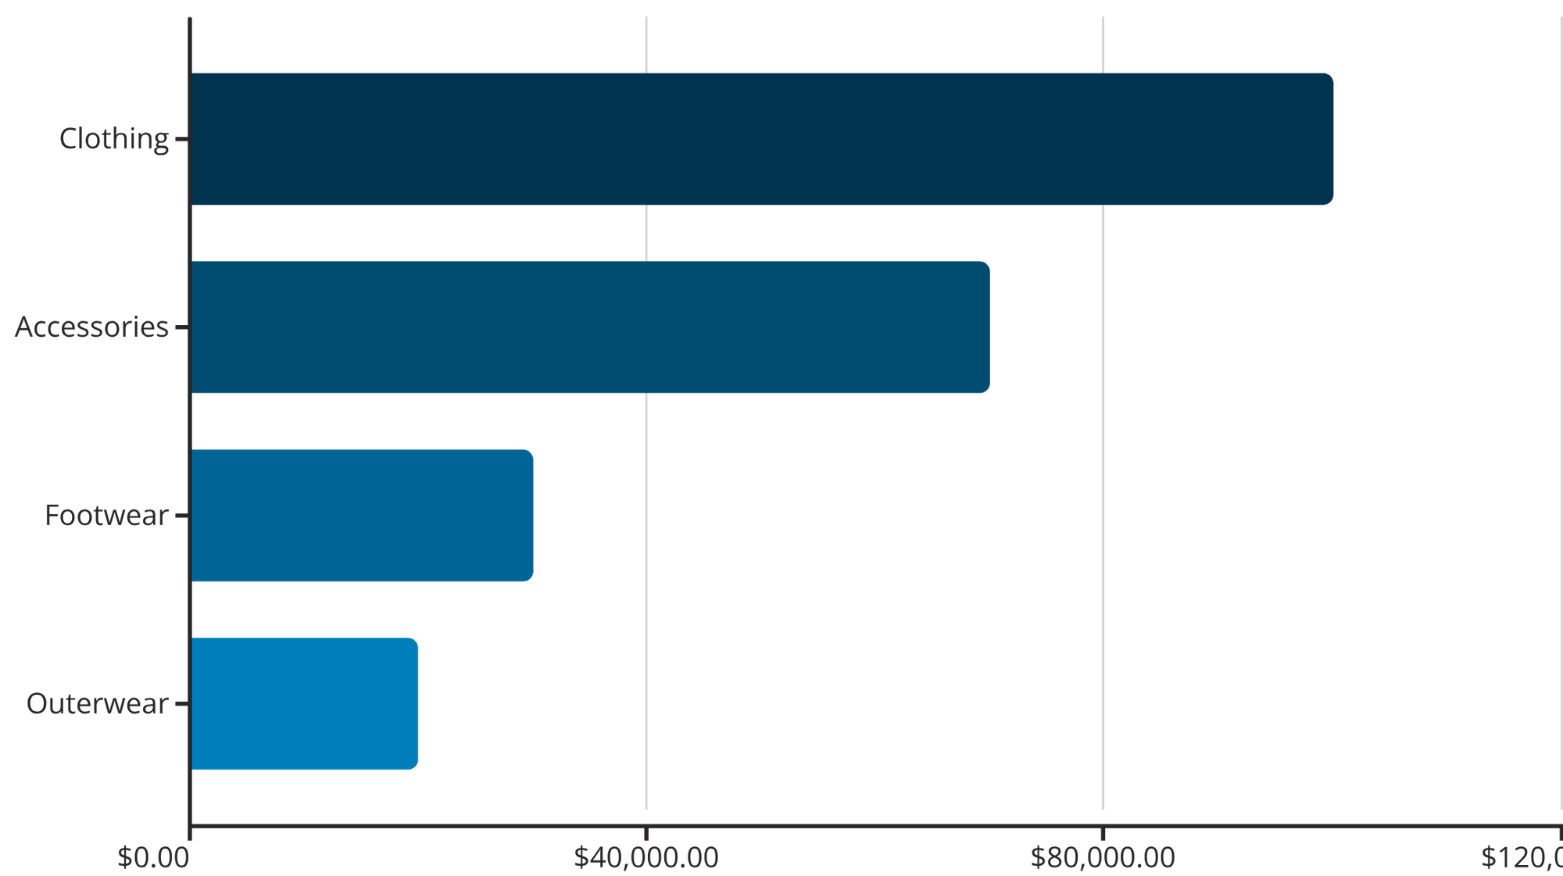
REVENUE BREAKDOWN
Category & Age Group Performance
Age Group Contributions
Young Adult: $62,143 revenue
Middle-aged: $59,197 revenue
Adult: $55,978 revenue
Senior: $55,763 revenue
Clothing dominates revenue at $100K. Young adults lead spending, suggesting targeted campaigns for this demographic.

Slide 9

Power BI Dashboard Highlights
3.9K
$59.76
3.75
Total Customers
Avg Purchase
Avg Rating
Comprehensive customer base analyzed
Consistent spending across segments
Strong customer satisfaction scores
Interactive dashboard enables real-time filtering by subscription status, gender, category, and shipping type—providing stakeholders with actionable insights for strategic decision-making.

Slide 10


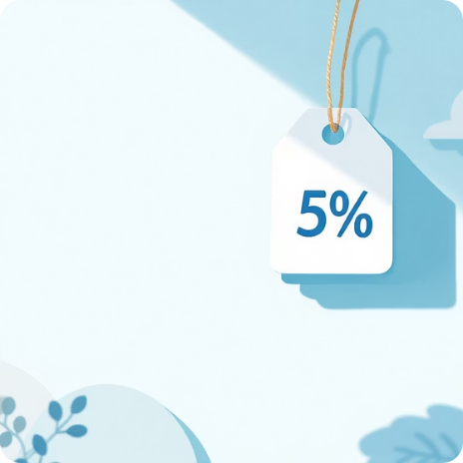

ACTION ITEMS
Strategic Business Recommendations
Boost Subscriptions
Loyalty Programs
Review Discounts
Targeted Marketing
Promote exclusive benefits to convert the 73% non-subscriber base
Reward repeat buyers to strengthen the 80% loyal customer segment
Balance promotional sales with margin control for high-discount products
Focus on high-revenue young adults and express-shipping users

